Slide 1
CURVATURE CACULATION OF RIGHTHAND FREQUENCY CUTOFF LAYER
Xxh
20200112

Slide 2
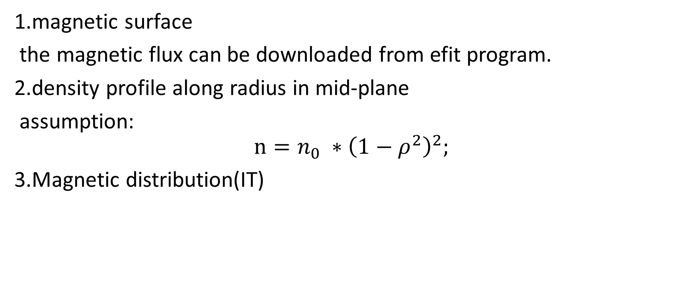
一：prerequisite
1.magnetic surface
the magnetic flux can be downloaded from efit program.
2.density profile along radius in mid-plane
assumption:
$$n=n_{0} ∗{\left(1−ρ^{2}\right)}^{2};$$
3.Magnetic distribution(IT)

Slide 3
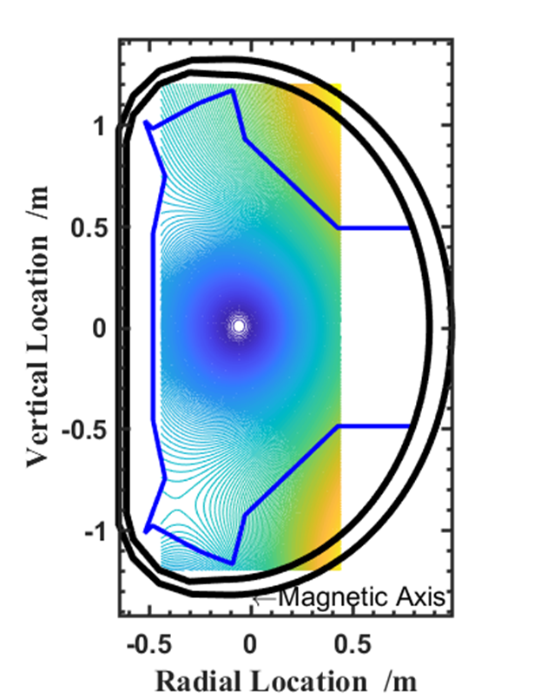
二：magnetic flux and density profile
close all
clear all
clc
shot=86999;
IT=10000;
R0=1.85; % major radius
n0=3*1e19;
for t=5
tslice=t;
defit=read_efit_data(shot,tslice);
x_raw=defit.refit-1.85;
z=defit.zefit;
[a,~]=find( x_raw>-0.45 & x_raw<0.45 );
x=x_raw(a);
rho=x/0.45;
psi_raw=defit.psirz';
psi=psi_raw(:,a) ;
[C,h]=contour(x,z,psi,200);
mcrossection(R0)
hold off
end
Contour line of magnetic flux

Slide 4
Preset profile of electron density
Density profile
Density distribution

Slide 5
三：right hand cutoff frequency distribution and cutoff curvature radius

Slide 6
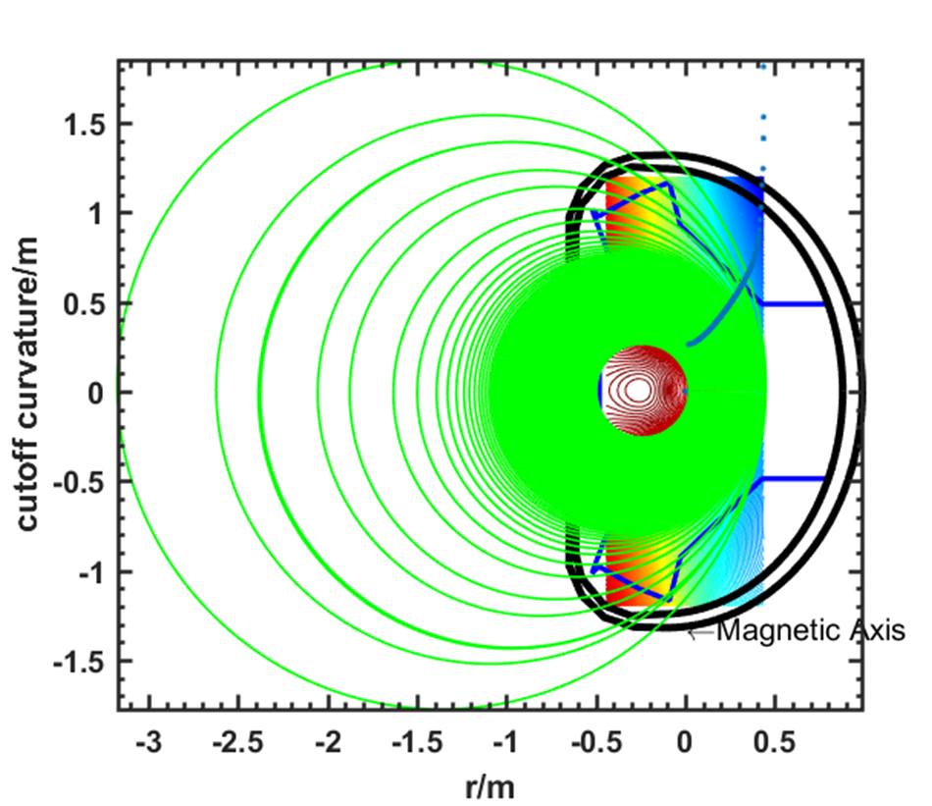

Slide 7
Adjustable curvature of MIR illumination optical

Slide 8
Summary
1.the perfectly match position is suitable for radius from 0.25m to 0.45m.
2.the cutoff curvature radius increase exponentially with minor radius.
3.density distribution still needs to validate from experiment.

